Slide 1
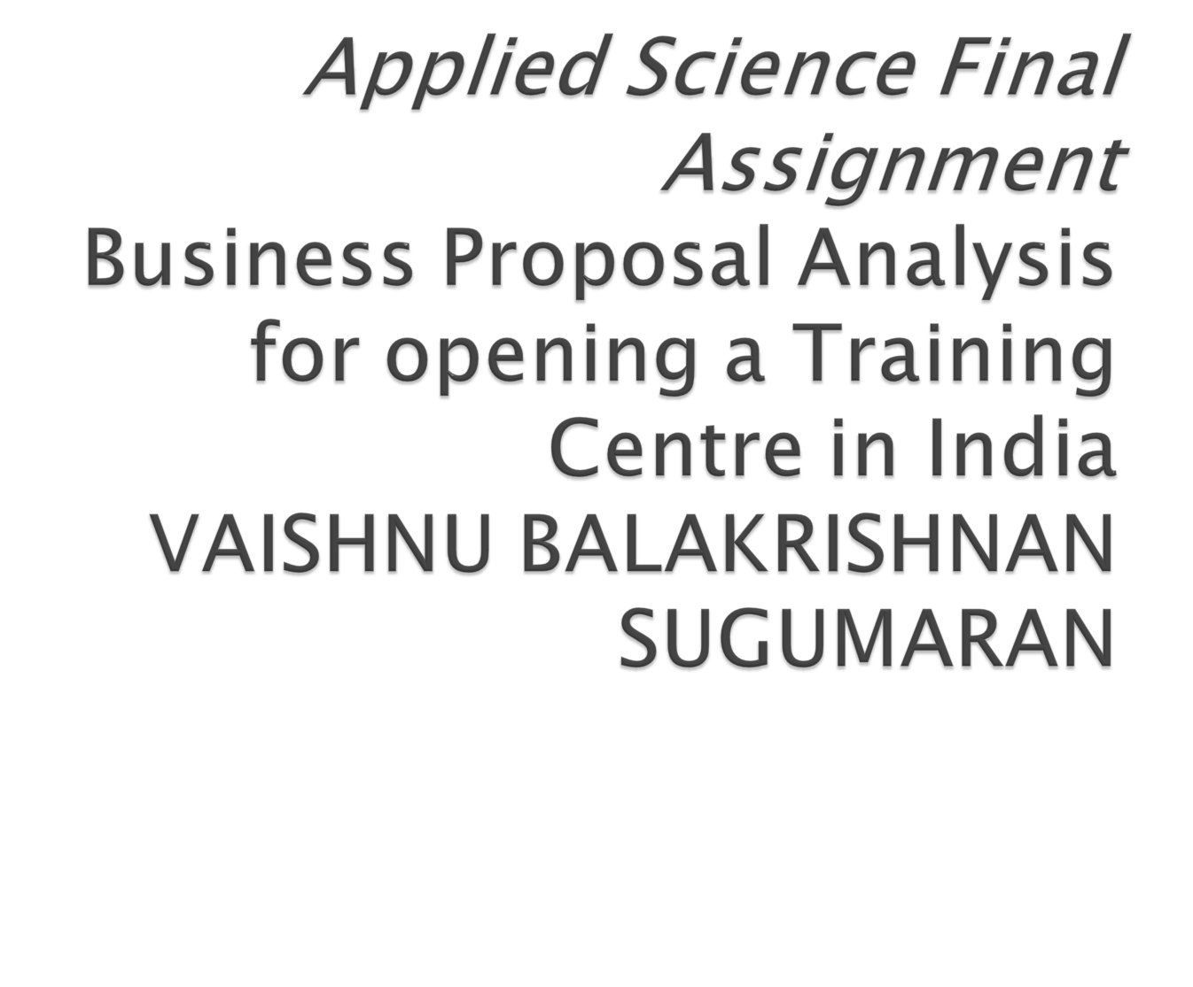

Slide 2

The objective of this project is to analyze and select the best locations in India to open training centers. This project is mainly focused on the analysis of 2011 census data to understand where there is a need to start- up educational institutions

Slide 3

To solve the problem, we will need the following data: 2011 district census data. This dataset contains data like literacy rate, population, sexratio and growth rate.
•Latitude and longitude coordinates of those neighborhoods. This is required in order to plot the map and also to get the venue data.
• Venue data, particularly data related to shopping malls. We will use this data to perform clustering on the neighborhoods.

Slide 4

First step is to get a list of districts and their census data for the year 2011. This dataset can be acquired from the official Indian census website:
https://www.census2011.co.in/district.php
To extract the data, we will do scraping using Python Requests and Beautiful soup package and convert it into a data frame

Slide 5
The basis of our problem are the low literacy rates so to analyze the data I decided to focus on literacy rate and how it effects the other properties like population, sex ratio, growth rate etc.
I started with calculating the average literacy rate amongst the districts and used that figure as a marker: considering literacy rates below it to be low and above it to be decent.

Slide 6
Plotting the district literacy rates against district population, I realized that districts with low literacy rates have low population densities
I further reduced the dataset to districts with literacy rates less than 50% to understand how literacy rate effects the growth rate of districts.

Slide 7
To understand how literacy rates and sex ratios of the districts are related, I created a subset of districts with high sex ratio from the original dataset. I found out that most districts with high sex ratios have above average literacy rates.

Slide 8
The states with literacy rates lower than the average are:
1. Andhra Pradesh
2. Arunachal Pradesh
3. Assam
4. Bihar
5. Chhattisgarh
6. Gujarat
7. Haryana
8. Jammu and Kashmir
9. Jharkhand
10. Karnataka
11. Madhya Pradesh
12. Orissa
13. Punjab
14. Rajasthan
15. Uttar Pradesh

Slide 9

There is a need to put focus of on this issue of literacy. Investment should be made in educating lower caste and rural communities as well as there is a need to focus on increasing female literacy in India.

Slide 10


